Slide 1
PARTS OF A COMPUTER (컴퓨터의 부품)

Slide 2
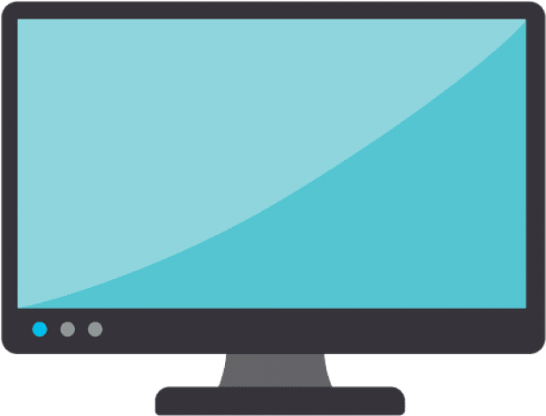
MONITOR
Shows what you are doing on the computer

Slide 3
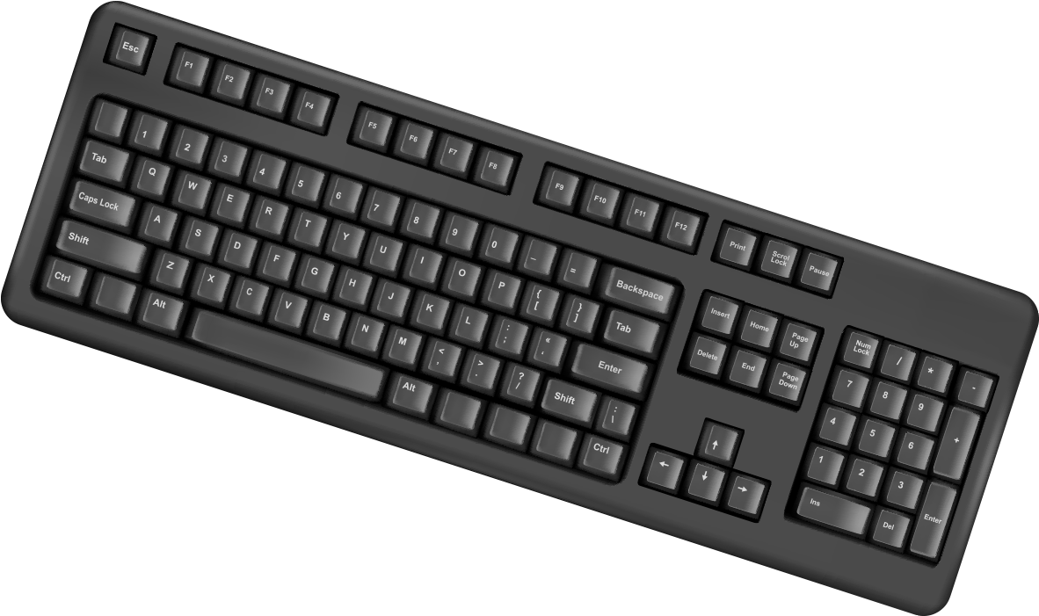
KEYBOARD
Used to type letters, numbers and symbols

Slide 4
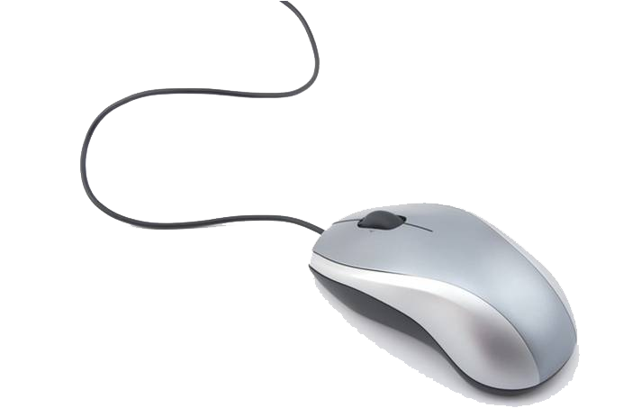
MOUSE
Moves the arrow on the monitor and select things

Slide 5
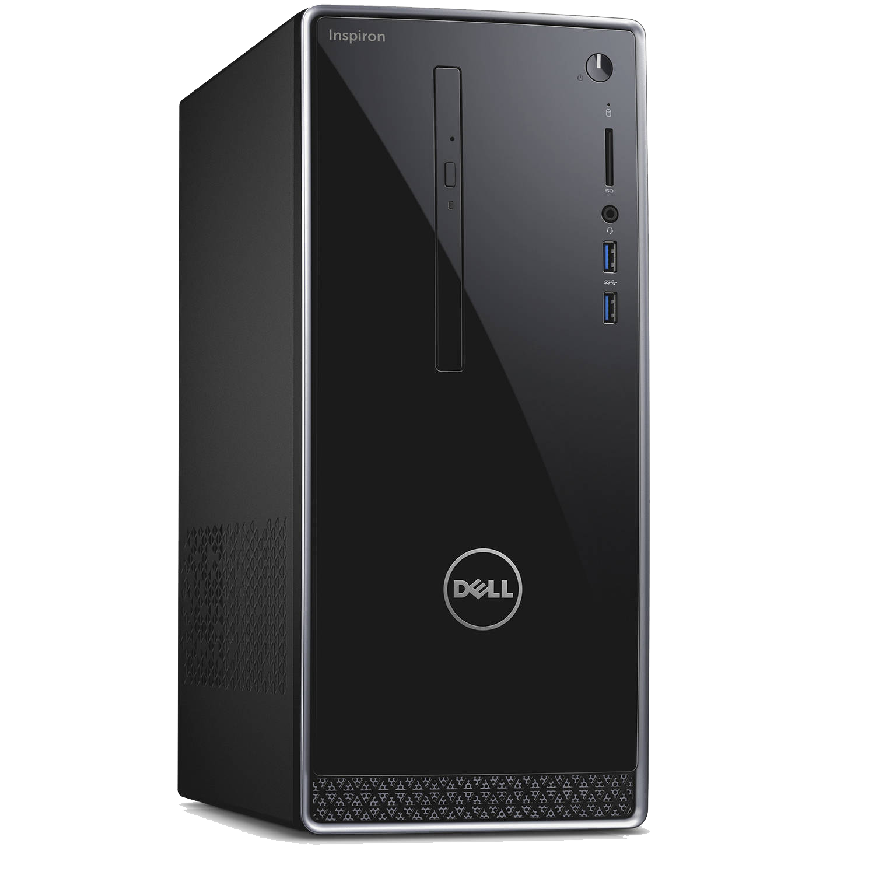
DESKTOP
Inside parts of the computer are stored in the desktop.
Powered by plugging into a power source

Slide 6
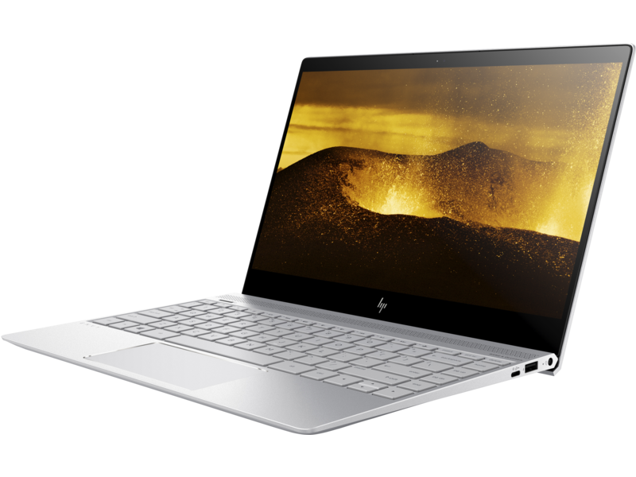
LAPTOP
A computer that is easy to fold and carry around

Slide 7
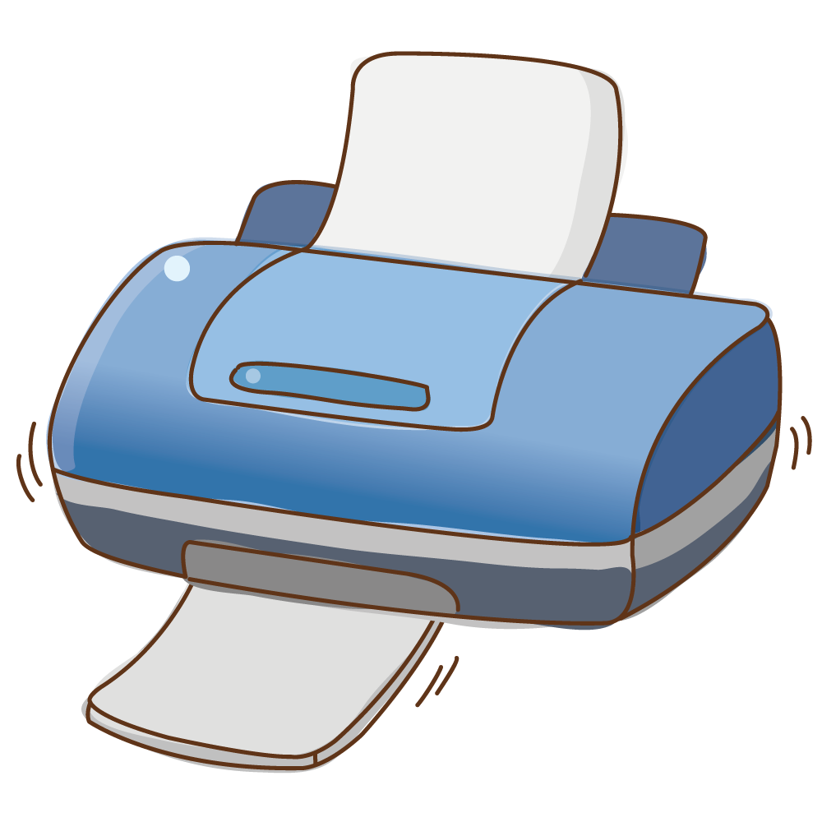
PRINTER
Prints whatever images and texts are on the screen onto a piece of paper

Slide 8
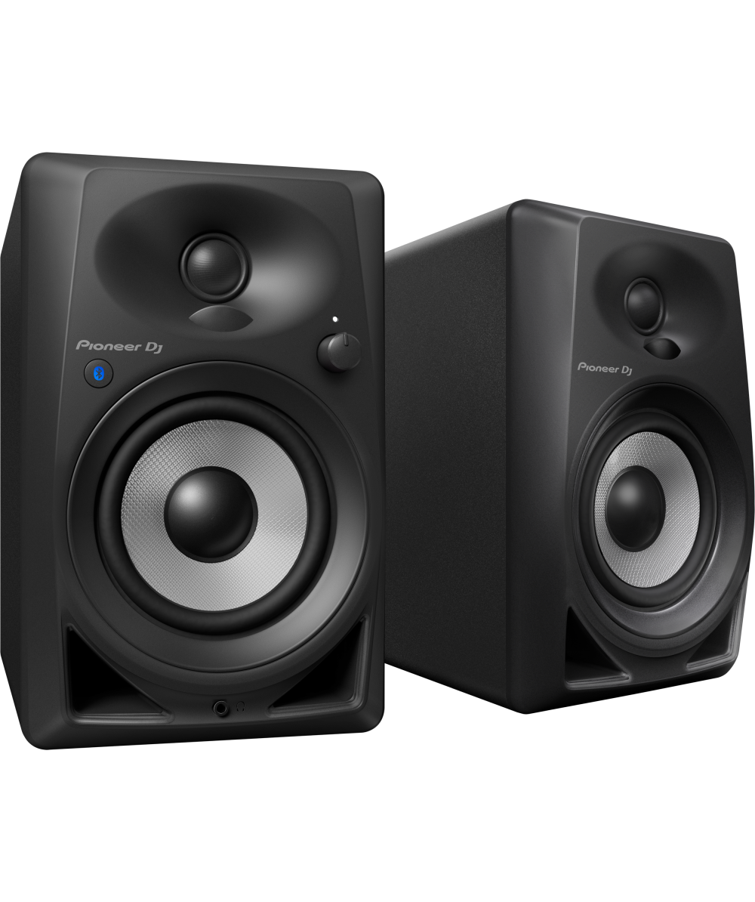
SPEAKER
To hear sounds playing from the computer

Slide 9
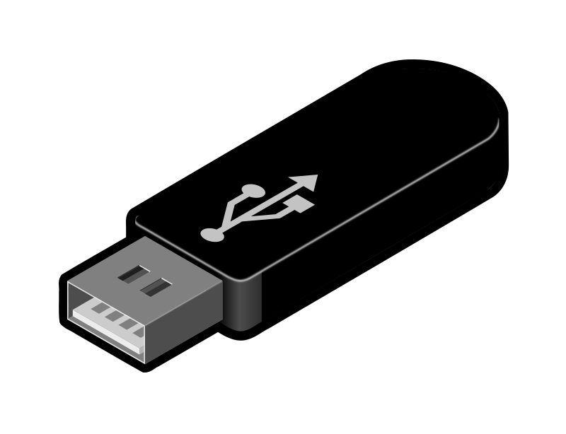
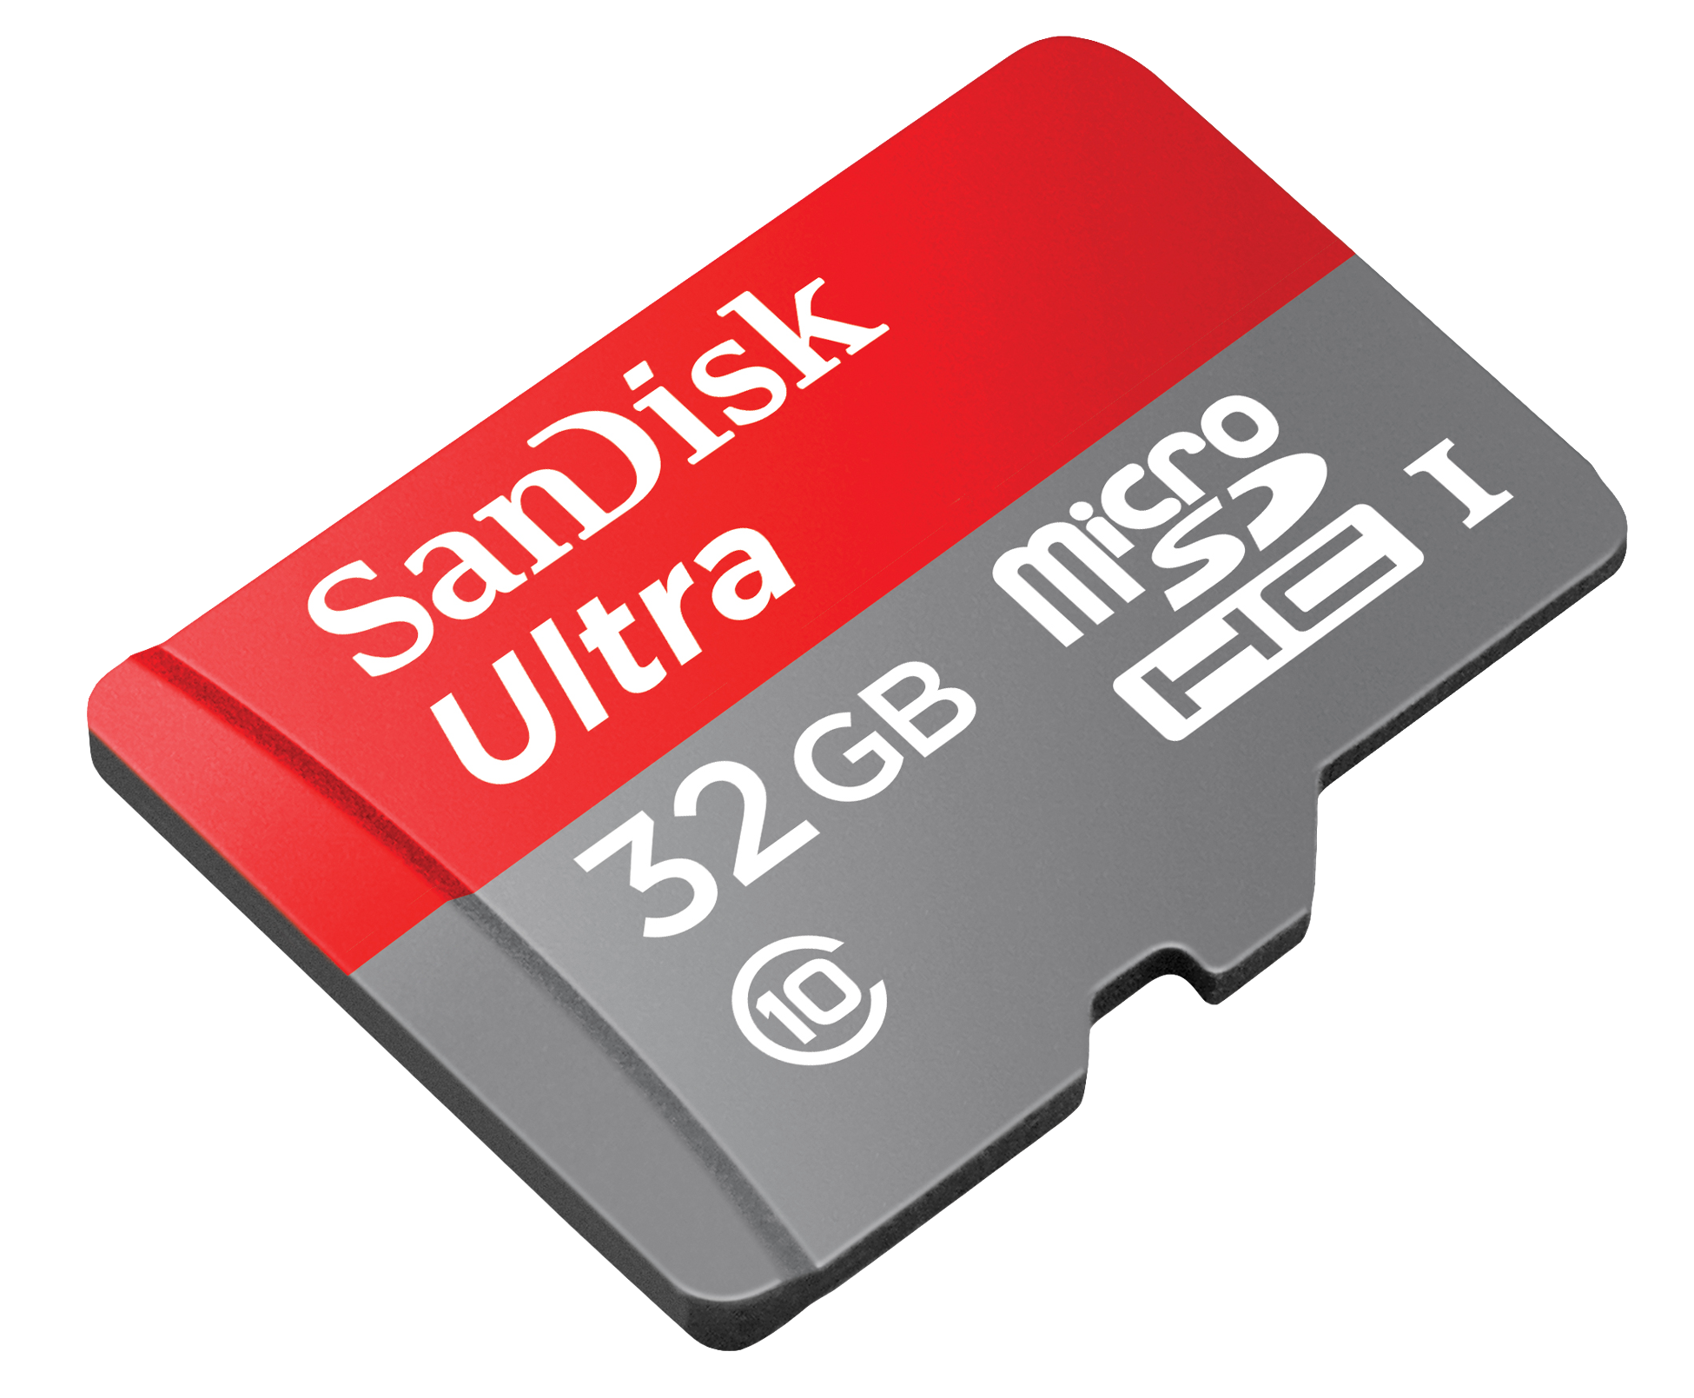
USB/Storage Device
Store files, pictures & songs. This can be used anywhere that has a USB slot

Slide 10
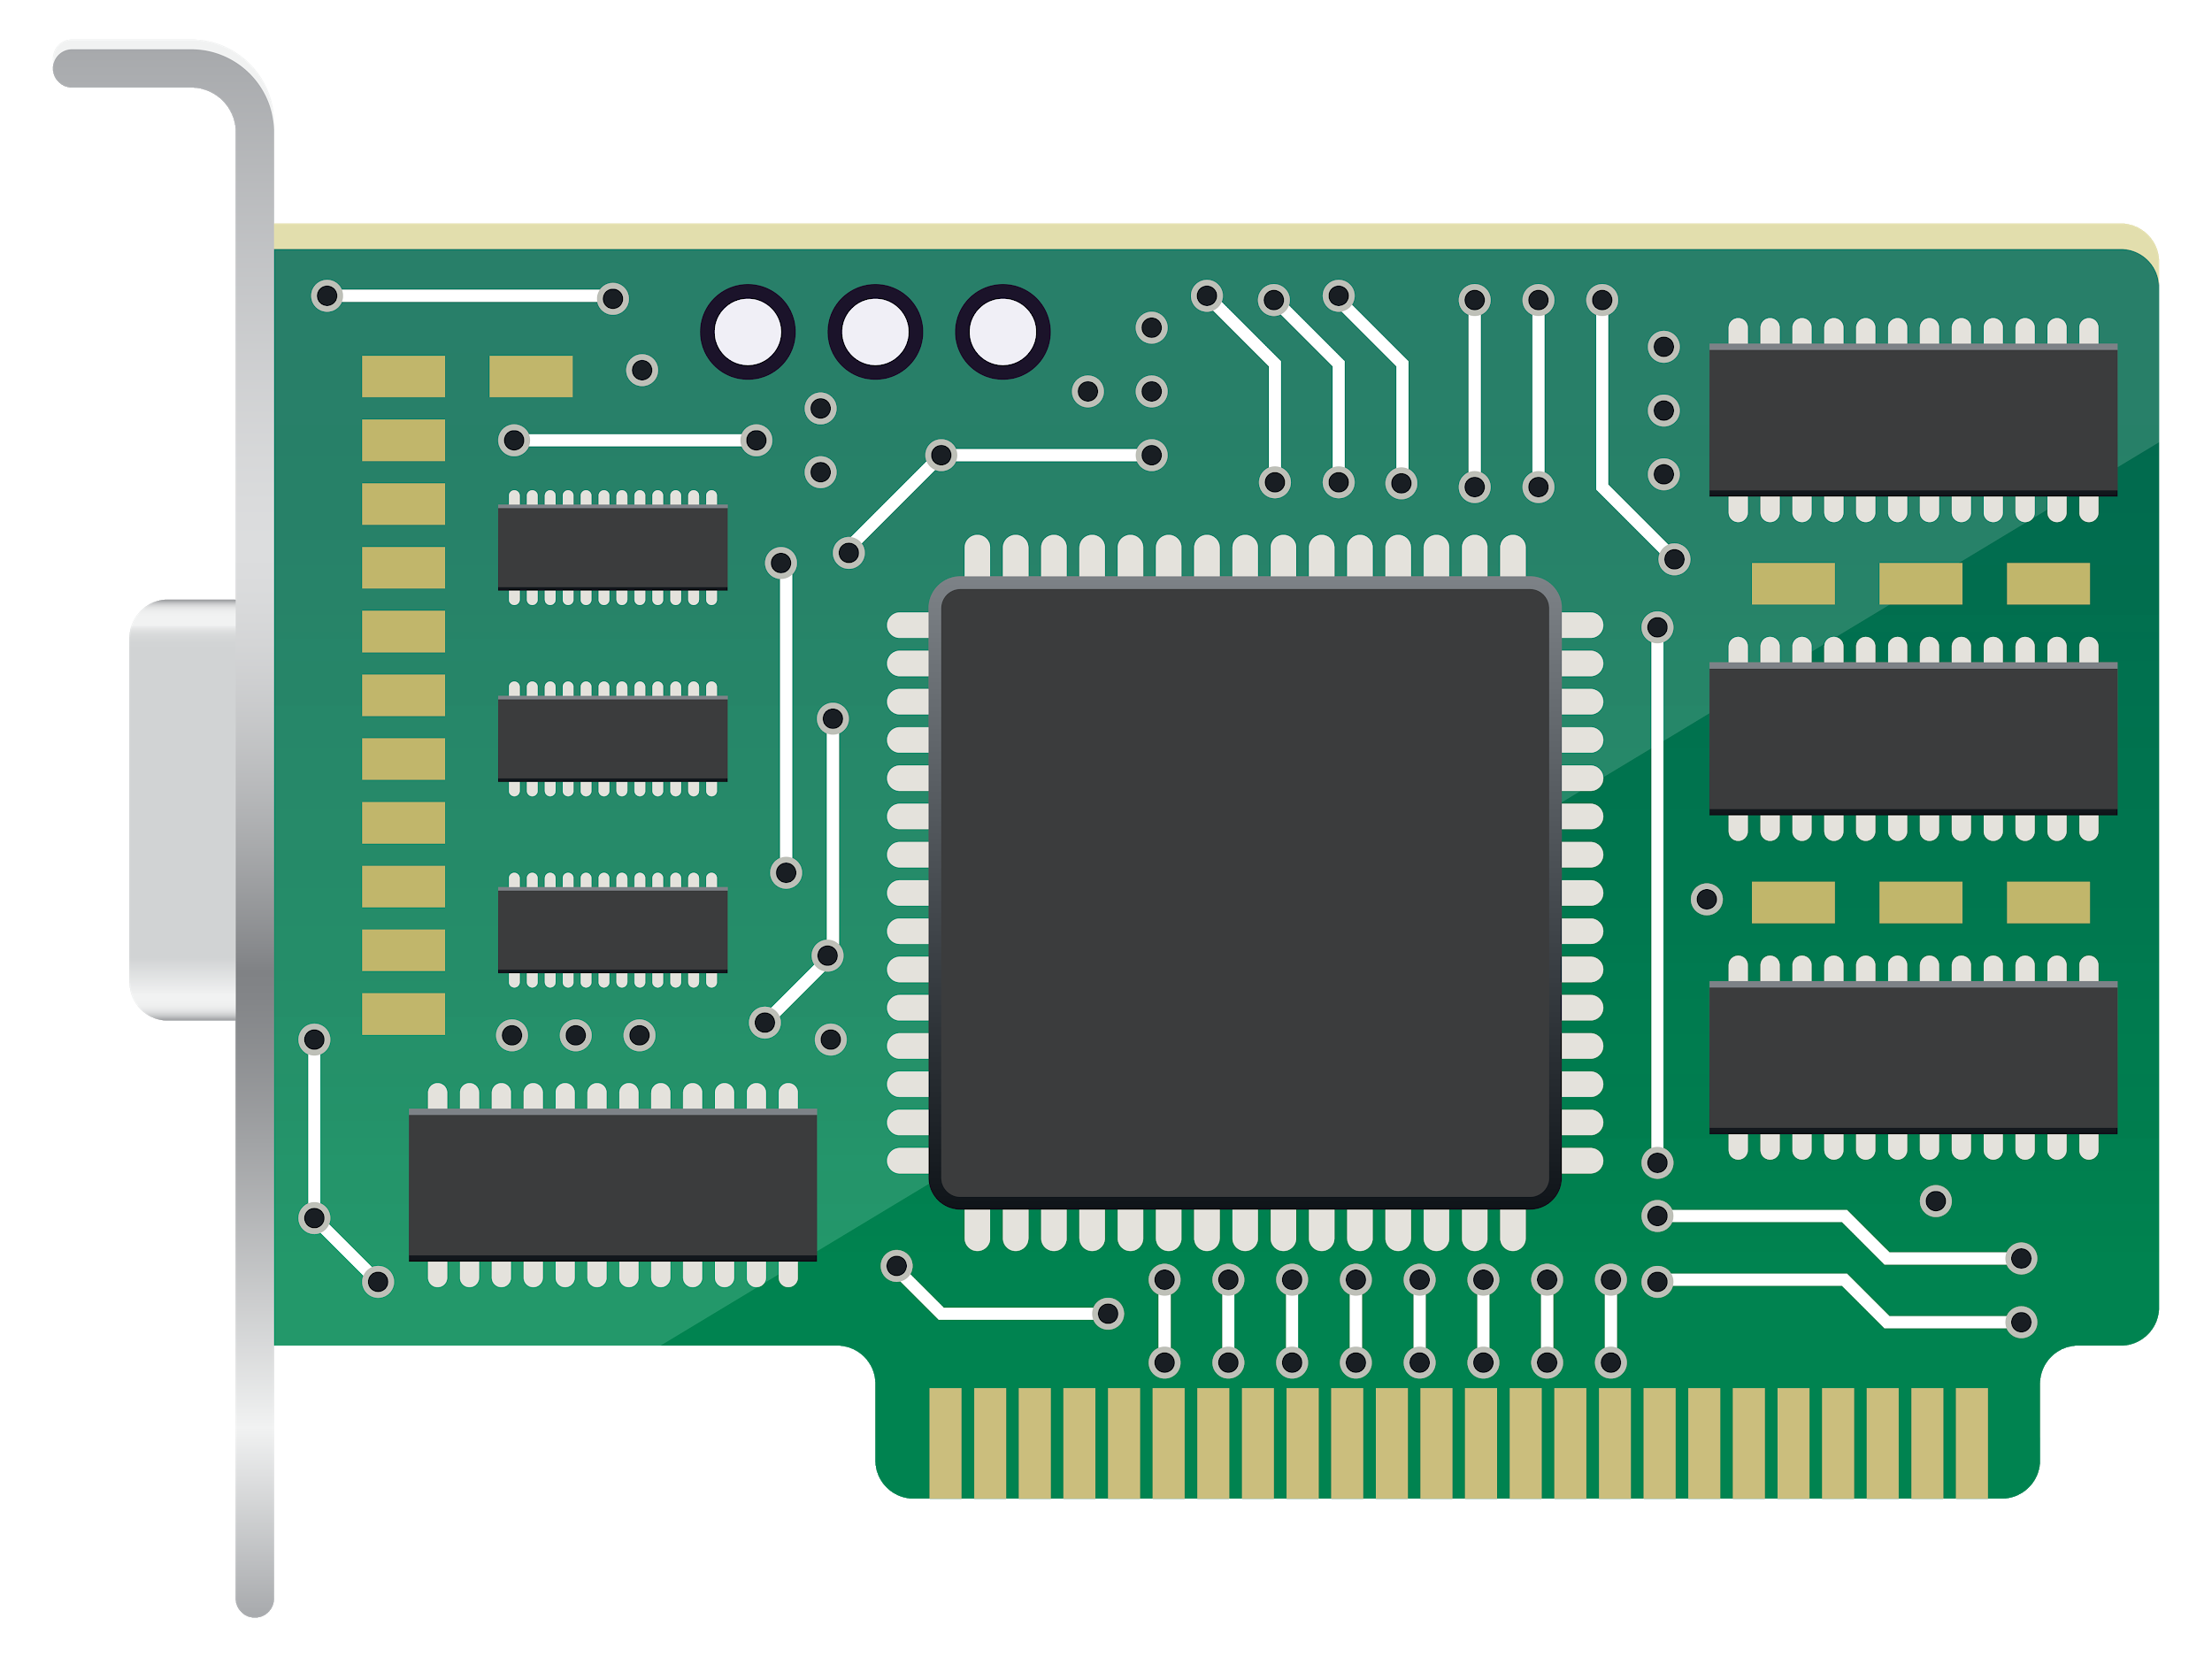
CPU/MOTHERBOARD
Brain of the computer/Communication between other parts of the computer

Slide 11
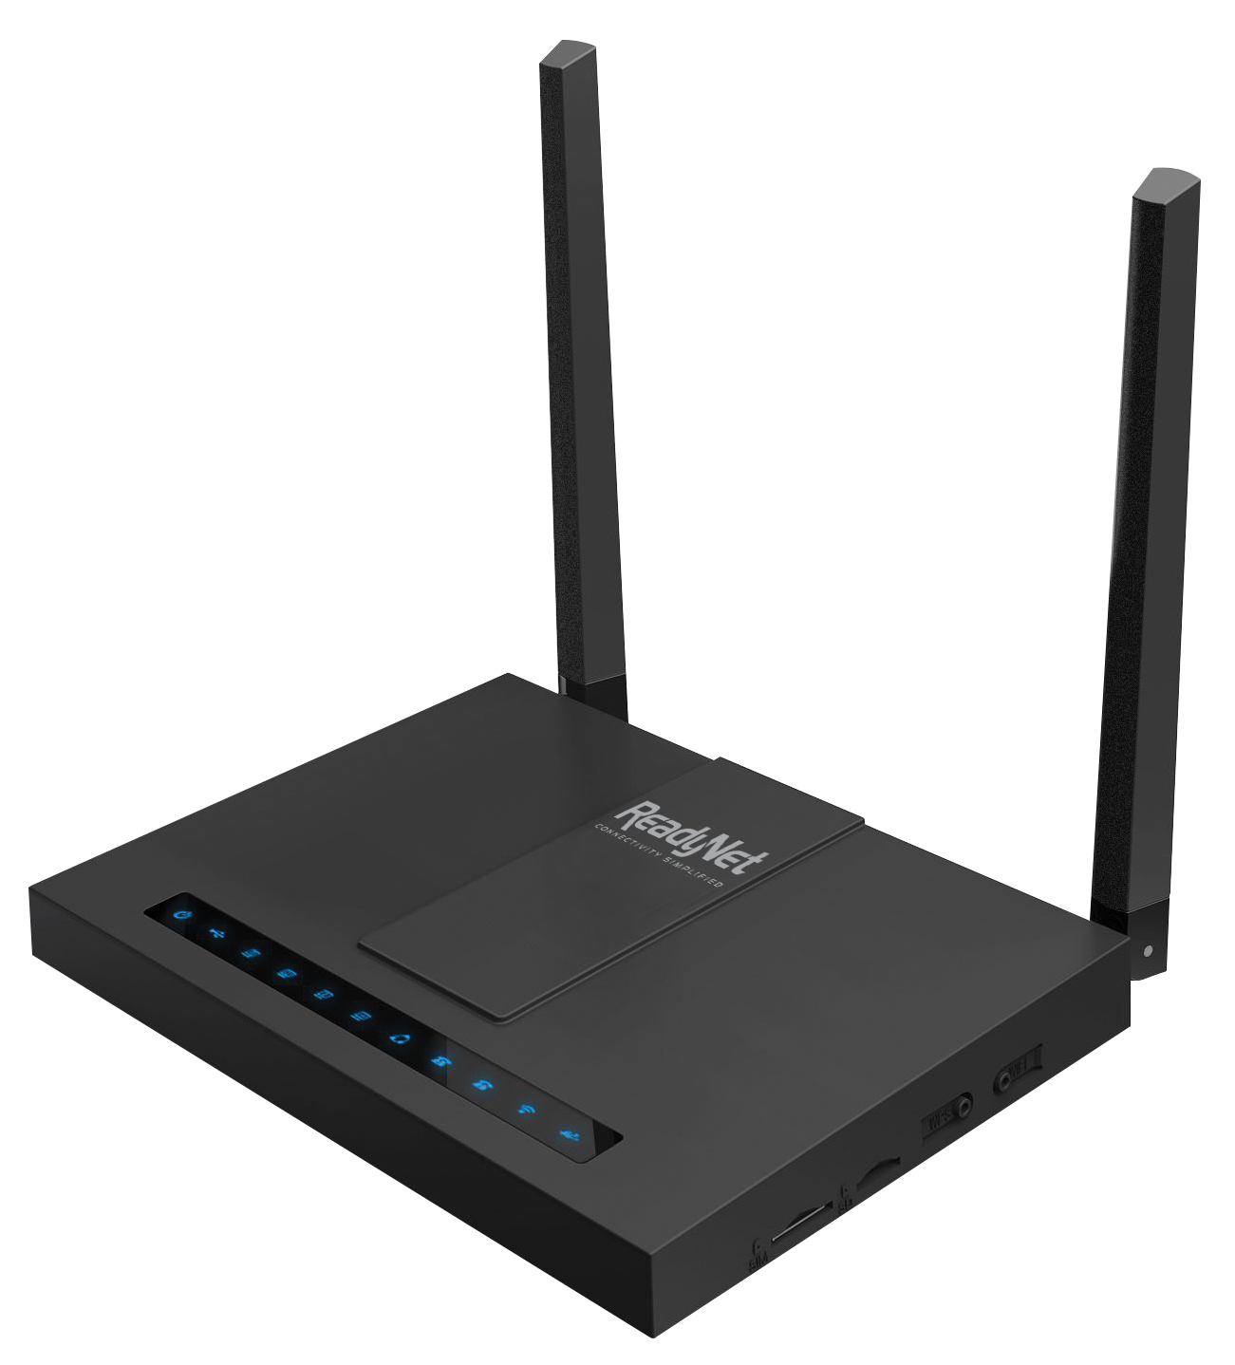
ROUTER
Connects the computer to the internet

Slide 12
THANK YOU FOR WATCHING!
봐줘서 고마워!

